Slide 1
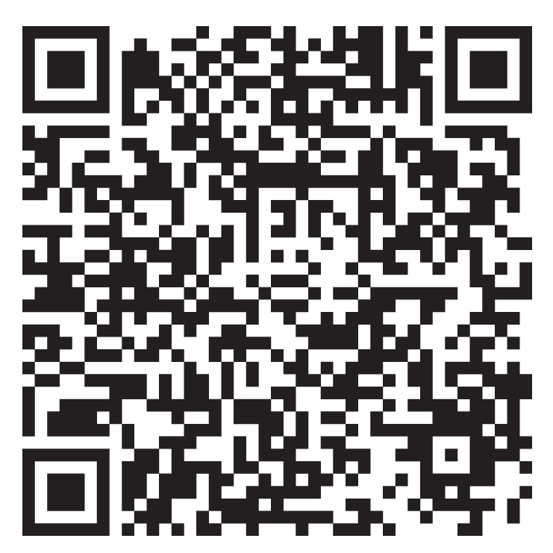
Lutheran Disaster Response: Crisis in the Holy Land
As the conflict between Hamas and Israel continues, the humanitarian crisis in the Holy Land continues to worsen. Lutheran Disaster Response is supporting longstanding partners in the region, including Augusta Victoria Hospital and the Evangelical Lutheran Church in Jordan and the Holy Land, to provide humanitarian aid for those within and outside of Gaza.
Scan to learn more and make a gift to support the response:

