Slide 1
Accompaniment
A Lens & Methodology
for Mission Today

Slide 2
“
Walking together in solidarity, that practices interdependence and mutuality.
In this walk, gifts, resources and experiences are shared with mutual advice and admonition to deepen and expand
our work within God’s mission.
“

Slide 3
Context of Accompaniment
Began as a conversation amongst
  Lutheran churches in Latin America
  Latin America and Caribbean Desk within ELCA Global Mission (GM)
Captured in 1995 Strategy document
  Strategy for Latin America and Caribbean
  Drafted in Spanish (first non-English policy document)

Slide 4
Context of Accompaniment
Strategy presented to GM Board
  Presented by the President of Iglesia Luterana
  "Fe y Esperanza", Nicaragua
Creation of GM Mission Strategy
  Adopted in 1999
  In “Global Mission in the Twenty-First Century: A Vision of Evangelical Faithfulness in God’s Mission”
  Guides ELCA Global Mission

Slide 5
Context of Accompaniment
Acknowledge Positives
  Churches have been started
  Education and healthcare provided
Acknowledge Negatives
  Local culture often denied or ignored
  Local people excluded from decision-making
  Local churches experienced dependency rather
  than autonomy

Slide 6

Context of Accompaniment
Current Example
  Christians in Africa
    Since 1900 increased 4,400%
    By 2025, will be almost
    600 million
  Christians in Europe
    By 2025 total number will drop by
    18 million

Slide 7
What is Accompaniment?
Not a new theology
  A new understanding of mission theology
A living concept
  Continues to be articulated and contextualized
  Grows in relationship with companion churches

Slide 8

God is a Sending God
Missio Dei – “Mission of God”
  Describes activity within divine Trinity
  Prepares the way for mission
  Flows from God’s nature
What is God’s nature?
  Process for creation
    Creating
    Redeeming
    Sustaining

Slide 9

God is a Sending God
What is our role?
  We are the salt and the light
ELCA’s mission statement
  “Marked with the cross of Christ forever, we are claimed, gathered and sent for the sake of the world.”
  God’s work. Our hands.

Slide 10
Justification & Sanctification
Two-movement symphony
  Justification – God’s movement toward us
  Sanctification – God reconciles us in community
Justification
  Done through Christ
  Frees us from ourselves
  Frees us from the guilt or consequence of sin

Slide 11
Justification & Sanctification
Two-movement symphony
  Justification – God’s movement toward us
  Sanctification – God reconciles us in community
Sanctification
  Move from Self to Other
  Holy Spirit empowers us for the work of reconciliation

Slide 12



Justification & Sanctification
God
Justification
Other
Individual
Sanctification

Slide 13
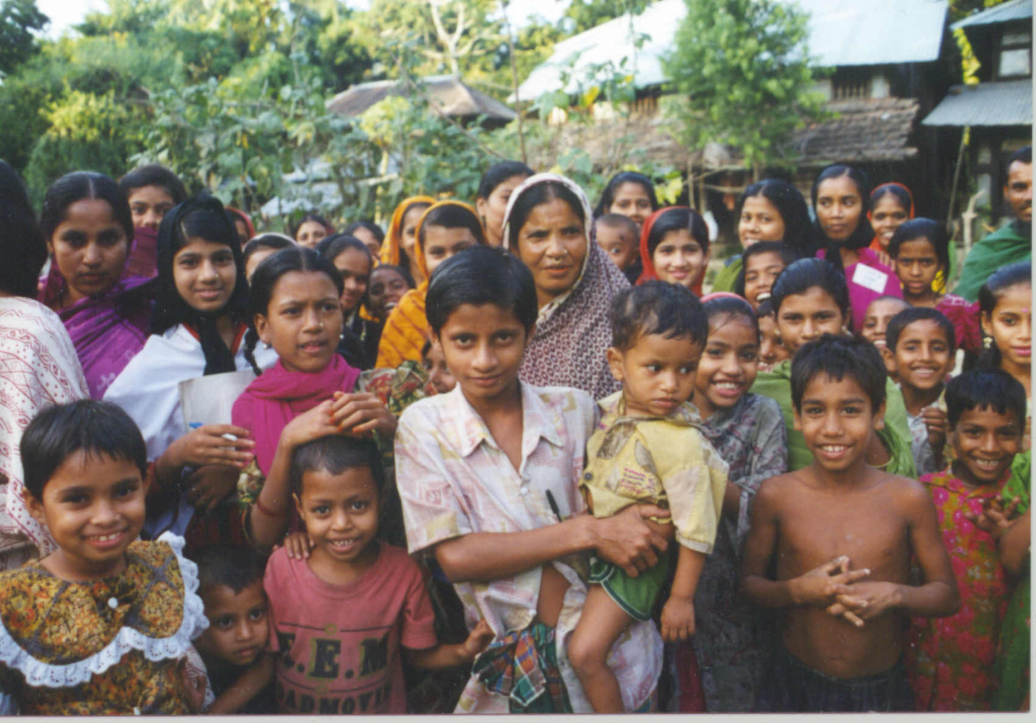

Reconciliation
Mission

Slide 14

Accompaniment as Lens
The Lost Sheep (Luke 15:1-7)
  Two groups*
    99 sheep
    1 “lost” sheep
Where is the emphasis?

Slide 15
Accompaniment as Lens
Emphasis on the 1
  Problem: Sheep is lost
  Solution: Determine lost sheep’s needs
  and find sheep
  When Found: Lost sheep should be thankful
Emphasis on the 99
  Problem: 99 are incomplete
  Solution: Find lost sheep
  When Found: 99 should be thankful

Slide 16
Implications: 3 Stories
God
My
Your

Slide 17
Impure Motives
God
Engagement
Oppression
My
Your
Imperial Motive

Slide 18
Impure Motives
God
Engagement
Oppression
My
Your
Cultural Motive

Slide 19
Impure Motives
God
Engagement
Oppression
My
Your
Romantic Motive

Slide 20
Impure Motives
God
Engagement
Oppression
My
Your
Ecclesiastical Colonialism Motive

Slide 21
Implications: 1 in 3 Stories
God
My
Your

Slide 22
Change of Perception
From | To
Colonial | Egalitarian
Short-term | Sustainable
Charity | Justice
Talking | Active Listening
Teacher | Active Learner
Suggesting | Comprehending

Slide 23
Change of Perception
From | To
Establishing | Accompanying
Dependent Church | Four Selves Church
My & God’s Story | Our Story
Pearl Merchant | Treasure Hunter
Over There | Everywhere
Dependency | Ecosystems

Slide 24

Summary
Accompaniment is a Lens
  For interpreting Scripture
  For reading the history of mission
    Where we were driven by “impure motives”
    Where we developed “best practices”
Each church is responsible for ministry
  In their context
  Role of other churches is to accompany

Slide 25
Thank You

