Slide 2
Workshop agenda
Welcome and introductions
History
Central America – root causes
The journey
What happens in the U.S.
AMMPARO
What can you do?
Wrap-up

Slide 3
God is our refuge and strength, a very present help in trouble.
– Psalm 46:1

Slide 4
In a holistic, whole church commitment by the ELCA, as a church in the world, AMMPARO was envisioned to accompany children who are forced to flee their communities today and in the future.

Slide 5
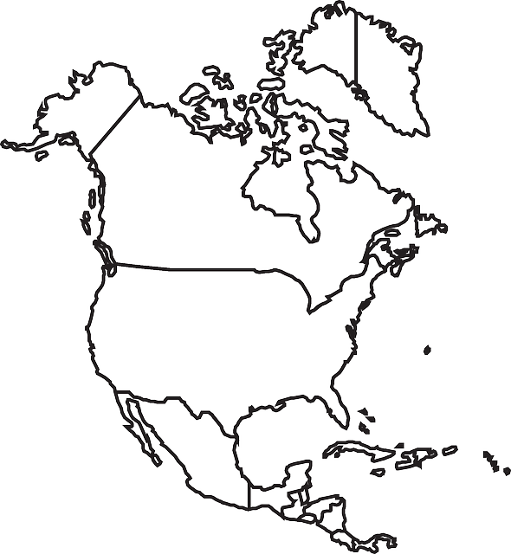
Impact In the U.S
More than 30,000 families and 908 children served, legal services for 25, 212 Welcoming Congregations in 56 synods, two Guardian Angel programs, 125 Capitol Hill visits on March 29, plus LIRS.
In transit
Pending
Impact in countries of origin
El Salvador: Youth micro-enterprises established, trauma counseling offered, local committees, radio programming
Honduras: 379 youth with no plans to migrate again have jobs, 95 micro-enterprises established, psychological services offered, coordination with municipalities on local advocacy for youth, 800 families accompanied.
Guatemala: 23 Indigenous migrants speaking Maya Mam served in 12 municipalities and six non-indigenous, 14 individuals back in school, two with mental-health services, local advocacy

Slide 6





History of AMMPARO
Summer 2015
Spring 2016
Consultation
ELCA Church Council
Fall 2014
Fall 2015
Summer 2016
Lutheran Roundtable
Conference of Bishops
Synodical Vice Presidents
Latino Ministry Strategy
Churchwide Assembly
Notes:
The demonstrates the commitment that the ELCA churchwide team had to draft a strategy that received the input from companions and partners externally in the Roundtable and the consultation and also internally through the Church Council, Conference of Bishops, Synod VP’s and Latino Ministry Strategy group.

Slide 7
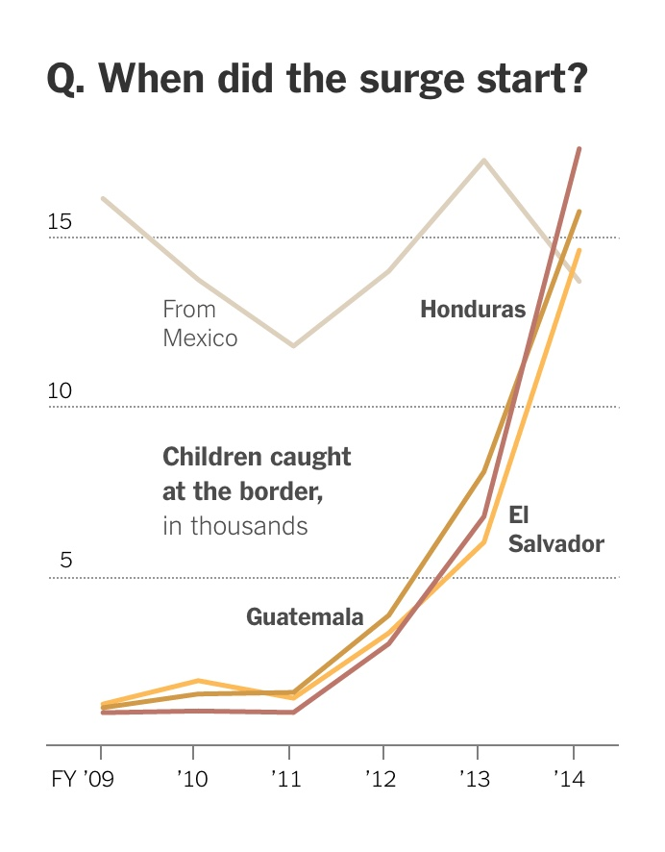
Central American Situation
According to U.S. Customs and Border Protection reports in the fiscal year ended Sept. 30, 2014, there were detentions of 68,541 children aged 17 and under who crossed the border unaccompanied by a parent or relative.
This compared to 38,759 the year before. This slide shows the numbers rising from 2011.
Source: The New York Times, nytimes.com/interactive/2014/07/14/us/100000003001471.mobile.html

Slide 8
Why are children, youth and families fleeing Central America?
Violence
Poverty and economic hardship
Climate change
Internal displacement is also significant

Slide 9
Homicides
2021 homicide rates in Northern Triangle countries
  Honduras – 38.6 per 100,000
  El Salvador – 17.6 per 100,000
  Guatemala – 16.6 per 100,000
  Compared to the approximate 2020 U.S. rate of 6.5 per 100,000
  Source: David Gagne, InSight Crime’s 2021 Homicide Round-up, Insight Crime, Feb. 1, 2022
Notes:
http://www.insightcrime.org/news-analysis/insight-crime-2016-homicide-round-up
https://fivethirtyeight.com/features/u-s-cities-experienced-another-big-rise-in-murder-in-2016/

Slide 10
Northern Triangle cities with the highest homicide rates
San Pedro Sula, Honduras – 42 per 100,000
Tegucigalpa, Honduras – 37 per 100,000
Source: Citizen Council for Public Security and Criminal Justice (CCSPJP), 2022.

Slide 11
Gender-based violence
50 percent of women in El Salvador reported some form of violence
In Guatemala, every 46 minutes a case of sexual violence was reported in 2015
In Honduras, a woman reports sexual violence every three hours
Notes:
According to the UTEC (Universidad Tecnologica) 50 percent of women in El Salvador reported some form of violence
In Guatemala, according to data recorded by the National Institute of Forensic Sciences of
Guatemala, in 2015, every 46 minutes a case of sexual violence was reported; 90 percent of
the victims were women or adolescent girls.
Centro de Derechos de Mujeres: 30,000 women report domestic violence each year, and a woman reports sexual violence every three hours.

Slide 12
Central American refugees
“Despite the horrors they have endured, refugees discover strength and resilience while in displacement. We need to empower them to contribute to their future and becoming agents of change.”
– Volker Türk
assistant high commissioner for protection,
U.N. High Commissioner for Refugees

Slide 13
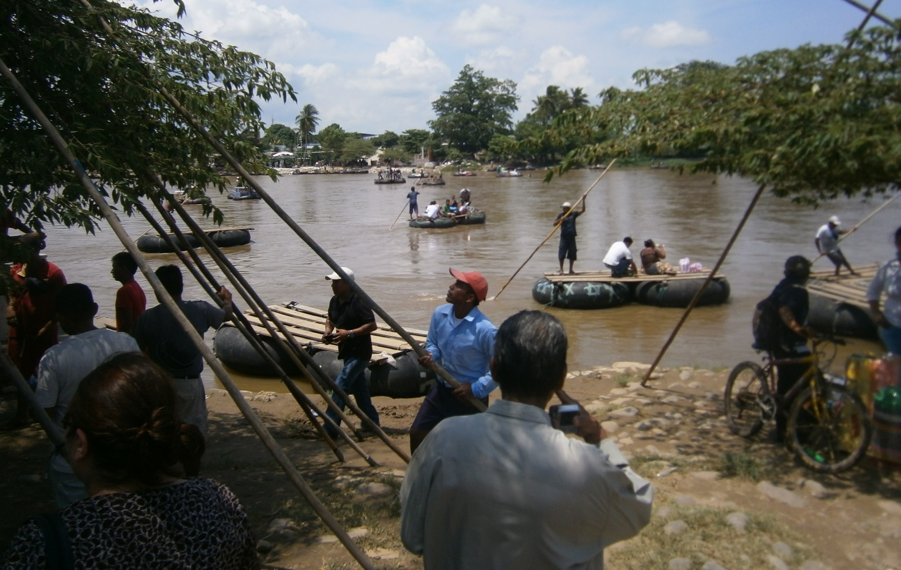
The Journey

Slide 14
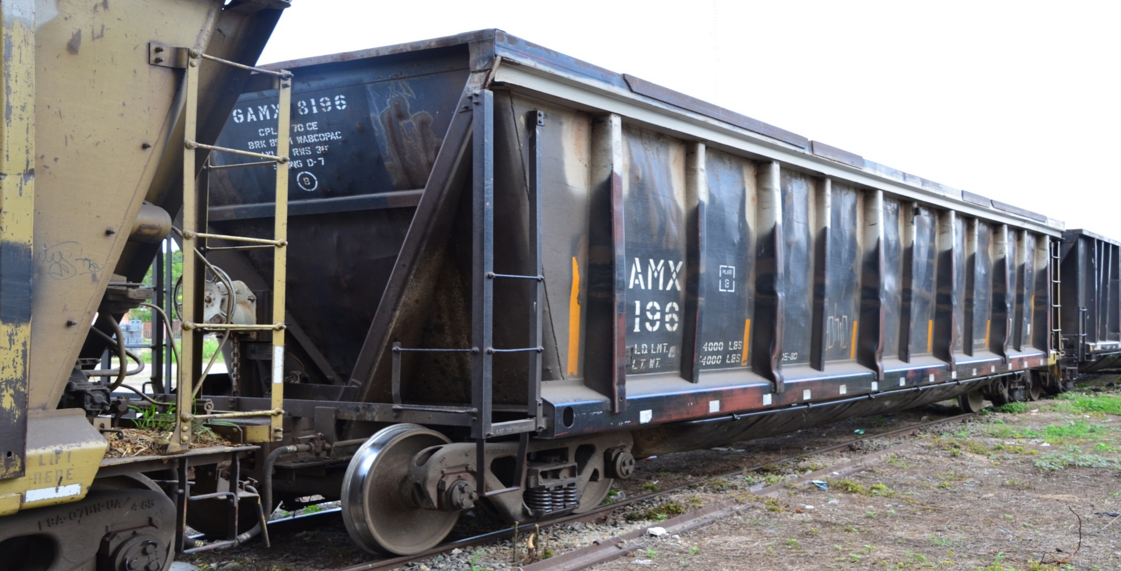
La Bestia Train, Tapachula, Mexico

Slide 15
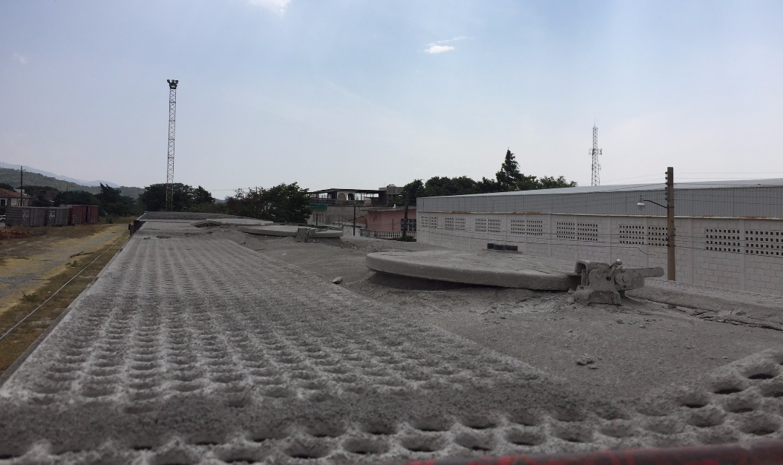

Slide 16
The journey: The problems
The dramatic increase in detentions and deportations in Mexico
While human trafficking is the most egregious example, “border as industry,” where everyone takes advantage of the migrant population, is the reality in southern Mexico.
New routes that are more isolated, more dangerous and that lengthen the time required to pass through Mexico
Notes:
The dramatic increase in detentions and deportations in Mexico is a direct result of the Southern Border Plan, financed partly and supported by the U.S. government.
While human trafficking is the most egregious example, “border as industry,” where everyone takes advantage of the migrant population, is the reality in southern Mexico.
Migrants have been forced to seek new routes that are more isolated, more dangerous and that lengthen the time required to pass through Mexico.
Virtually everyone who has contact with the migrant population in Mexico reports an increase in the number of entire families who are now making the perilous journey.
This means that more women and children are exposed to dangerous situations, including human trafficking.
Detentions and deportations are up dramatically in southern Mexico.

Slide 17
Selected videos
ELCA.org/AMMPARO
“A Mother and Child’s Story,” ELCA
“Guardian Angel Program,” ELCA
Others
“The Journey,” LIRS, https://www.lirs.org/the-journey/

Slide 18
U.S. situation
Updated numbers
from U.S. Customs and Border Protection
Comparisons for Oct. 1 to Sept. 30
Southwest border total
Children
Fiscal year 2019 Fiscal year 2020 Fiscal year 2021
76,020 30,557 144,834
  Families
  473,682 52,230 451,087

Slide 19
Approximate Numbers for FY 2022
126,580 unaccompanied children
399,057 family units
Notes:
These numbers reflect people who entered between October 2016 and December 2017. January numbers were also really high but have dropped starting in February.

Slide 20
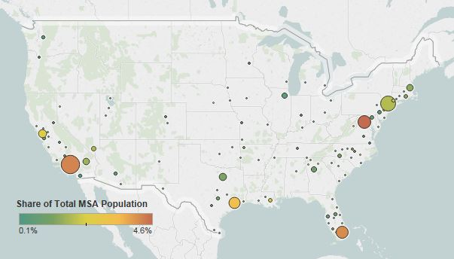
Figure 3. Top Metropolitan Destinations for Central American Immigrants in the United States, 2011-15
Notes:
Top metropolitan destinations for Central American immigrants in the United States, 2011-15 – top destination cities are Los Angeles; Washington, D.C.; and Miami, followed by Houston, San Francisco and New York.

Slide 21
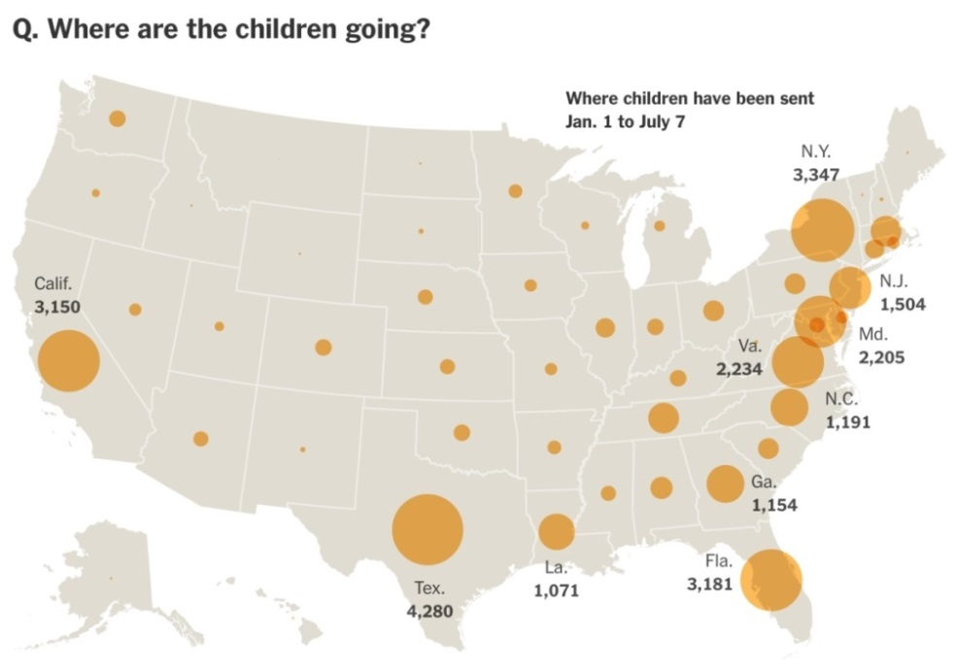
U.S. situation
From1/1/15 to 7/7/15, more than 30,000 unaccompanied minors were placed with sponsors, usually parents or relatives. They remain there while their cases are processed. The majority of the children are in states where immigrants have traditionally settled, like Texas, New York, California and Florida. A large number were also sent to Maryland, Virginia, Georgia and Louisiana.
Source: The New York Times, see above

Slide 22
The ELCA AMMPARO Strategy
4 commitments of a holistic, whole church response
3 moments of the journey – countries of origin, in-transit, U.S.
3 guiding principles – accompaniment, awareness-building, advocacy
4 activities – protection, advocacy, representation and opportunities

Slide 23
AMMPARO commitments
God is our refuge and strength, a very present help in trouble. – Psalm 46:1
In a whole church response, we will:
uphold and guarantee basic the human rights and safety of migrant children and their families;
address the root causes of migration in countries from Central America’s Northern Triangle and Mexico and the treatment of migrants in transit;
work toward just and humane policies affecting migrants in and outside the U.S.; and
engage as a church body with all of its companions, affiliates and partners to respond to the migration situation as a whole context and to advocate for migrant children and their families.

Slide 24
In the U.S
Lutheran Immigration and Refugee Service, Lutheran Services of America, Church World Service, and many more
In transit
Mexico: Iglesia Luterana Mexicana, AMEXTRA
Countries of origin
El Salvador: Iglesia Luterana Salvadoreña
Honduras: Iglesia Cristiana Luterana de Honduras, Mennonite Social Action Committee and The Lutheran World Federation (LWF)/World Service (WS)
Guatemala: Asociación Pop No’J, Iglesia Luterana Agustina de Guatemala and LWF/WS

Slide 25
Independent guiding principles
Accompaniment – projects, immersion visits
Awareness raising – learning opportunities, communication
Advocacy – Through the ELCA Washington Office and state public policy offices

Slide 26
AMMPARO ACTIVITIES
Protection
Advocacy
Representation
Opportunities

Slide 27
Welcoming Congregations
From the ELCA Southwest California Synod, commitments of a Welcoming Congregation: In obedience to Matthew 25:35 to welcome everyone
Listen to the stories of migrants with respect to receiving the divine blessings they bring
Four commitments: spiritual community by providing pastoral and emotional support, accompany for local and institutional services as needed, pray for, and advocate for justice for and with migrants

Slide 28
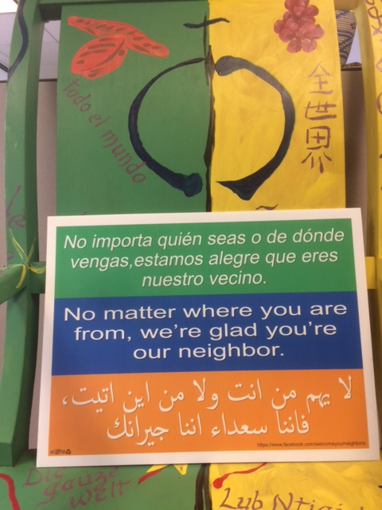
212 Welcoming Congregations
In Arizona, Arkansas, California, Colorado, Connecticut, Florida, Georgia, Idaho, Illinois, Iowa, Louisiana, Maryland, Massachusetts, Michigan, Minnesota, Missouri, Nebraska, Nevada, New Hampshire, New Jersey, New Mexico, New York, North Carolina, Ohio, Oklahoma, Oregon, Pennsylvania, Rhode Island, South Carolina, South Dakota, Texas, Vermont, Virginia, Washington, Wisconsin, Puerto Rico, and Washington D.C.

Slide 29
Local responses
Confronting overwhelming atmosphere of fear in communities – trainings on know your rights, act your rights; new sanctuary protection; local ordinances; engagement with schools
Bridging organized immigrant communities with faith communities – Welcoming Congregations with local groups
Connecting the causes driving migration in Central America with a broader agenda around inequality – Tax Day example
Bringing the voices of Central Americans displaced by violence and insecurity to the attention of local, state and national policymakers – visits

Slide 30
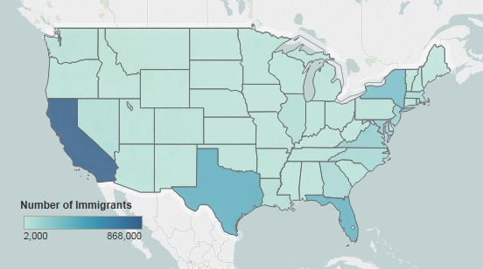
Figure 2. Top Destination States for Central American Immigrants in the United States, 2011-15
Notes:
Top destination states in the US

Slide 31
Asylum applications skyrocket
1,179.4 percent more applications from Northern Triangle countries to Mexico, Belize, Nicaragua, Costa Rica and Panama
369 percent more applications in the U.S. from the Northern Triangle
Source: UNHCR, Population Statistics, February 2016

Slide 32
ELCA Guardian Angel program for unaccompanied and migrant children
This program provides spiritual and physical accompaniment of unaccompanied migrant children and families through their immigration court process.

Slide 33
The ELCA partners with Lutheran Immigration and Refugee Service (LIRS) and other independent Lutheran organizations in ways that deepen and extend the ELCA’s commitment to accompany migrant children and families as well as refugees both here in the U.S. and around the world.
Notes:
In addition to accompanying companion churches and agencies in the Honduras, El Salvador, Guatemala and Mexico, the ELCA collaborates with LIRS and other independent Lutheran organizations such as the Lutheran Social Service network to provide protection, advocacy, representation and opportunities in the U.S.

Slide 34
The ELCA and LIRS collaborate in accompaniment through
Synod AMMPARO/immigra-tion task forces
Welcoming Congregations
Guardian Angels
Lawyers’ network
Detention visitation programs
Circles of Welcome for refugee resettlement
Foster care for minors
Refugee Sunday
Advocacy
Notes:
These are some of the ways the ELCA and LIRS collaborate. On the ELCA side, several synods have immigration task forces that connect with AMMPARO. At least two synods have specific AMMPARO groups. At this writing, there are 50 Welcoming Congregations. Your congregation is encouraged to become a Welcoming Congregation. This commits your congregation to spiritually and pastorally accompany migrant children and families. The Guardian Angel programs in Los Angeles and Chicago allow ELCA members to accompany migrant children and families in court. ELCA members who are lawyers are stepping up to provide pro bono representation to migrant children and families.

Slide 35

Circle of Welcome
Notes:
The Circle of Welcome is a new program that has been developed to engage Lutheran Immigration and Refugee Service, local resettlement affiliates and congregations and community groups in the long welcome of refugees. The Circle of Welcome conveys the idea that the refugee family is surrounded by a group of friends who embrace a friendship for a longer period and help refugees through the resettlement process, especially at a time of diminishing federal government support for resettlement.

Slide 36
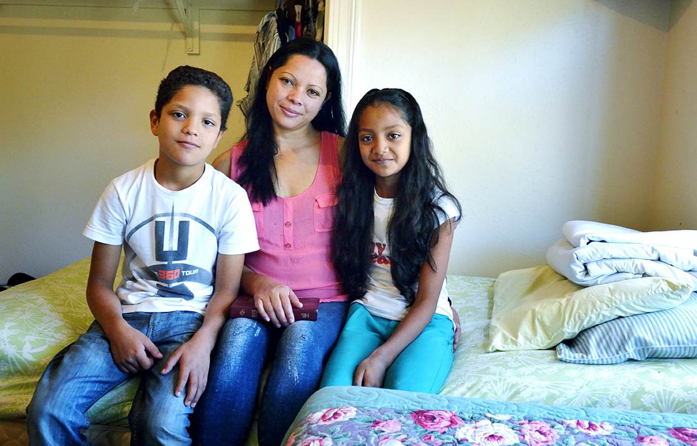


The time is right to focus
on the long welcome
Growing interest among churches
Expanding and deepening
Lutheran participation
Uncertainty in the U.S. refugee program
LIRS matching start-up grant up to $20,000
Why this new model of engaging faith and community groups in refugee accompaniment?
Notes:
The Time is Right: This initiative, The Circle of Welcome, comes at a time of great challenge to our shared mission of resettling refugees, providing them with critical services to rebuild their lives and forging meaningful relationships so that they are embraced as neighbors and recognized as contributing members of society. The Circle of Welcome initiative is a unique opportunity to strengthen relationships between Lutheran congregations, our regional resettlement service partners, and LIRS. It creates meaningful and varied ways for Lutherans and their congregations to engage with and accompany refugees in service, friendship, and as their advocates. LIRS is demonstrating its commitment to this Circle of Welcome program by making available a matching grant of up to $20,000 for 15 resettlement offices that are willing to step forward with congregations and community groups to complete the Circle of Welcome.

Slide 37
Post arrival model
Distant partner model
Newly arrived model
One initiative; three models
Notes:
The Circle of Welcome is one initiative using three models for resettlement:
The newly arrived model: This model engages volunteer teams in the Circle of Welcome even before refugees arrive. This model requires faith or community teams to be within a 50-mile radius of the local resettlement agency. This model can include assisting the local resettlement agency with preparing an apartment or home for the refugee family. This model allows the volunteer teams to engage with the refugee family from the day of their arrival, or within the first 90 days of arrival, and that early engagement often creates a lasting bond of friendship. This model includes the most comprehensive service opportunities. It involves the highest level of financial commitment between $6,000-$8,000, as the cost of resettlement is often most significant in the first three months.
Post arrival model: The unique characteristic of this model is that it involves engagement by volunteer teams with a refugee family that has already been in the United States for three months. This model assures that refugees who have already been here for three months can be included in the long welcome. Refugees benefit from an extended period of engagement by welcome teams, and this model makes the long welcome possible. This model allows local resettlement agencies to bring into the Circle of Welcome post-arrival refugees, especially when there is a decline in the number of newly arrived refugees. This model requires the faith or community teams to be within a 50-mile radius of the local resettlement agency. This model will not provide as many service opportunities as the newly arrived model, but it still provides a large range of service opportunities. The level of financial commitment is $4,500-$6,000 and is lower primarily because it does not involve the first three months of refugee resettlement where the cost of resettlement is often highest. This model provides the volunteer teams with a full year of engagement with the refugee family and plenty of opportunity to assist the family in numerous ways.
Distant partner model: The unique characteristic of this model is that it involves engagement by volunteer teams that are outside of the 50-mile radius of the local resettlement agency, however, it can also include teams within the 50-mile radius. This model was created specifically to give opportunity to any faith or community team to engage with a refugee family even if they are not within close proximity to the local resettlement agency. This model has the fewest service opportunities due primarily to the distance between the refugee and the volunteer team. Nevertheless, opportunity for a face to face visit is built into this model as are other means to provide assistance to the refugee family. This model allows the volunteer team to learn about a refugee family and their journey to the U.S. and throughout the resettlement process. There is a financial commitment $3,500-$4,500 as there will be opportunities to support the refugee family, and to be kept informed on a regular basis of their situation. This model also involves a one-year commitment.

Slide 38
Give the gift of family
Short- and long-term foster care for children and youth

Slide 39
Advocacy
Ensure the immediate protection of unaccompanied children and families fleeing Central America, while focusing on addressing the root causes of their forced displacement.

Slide 40
Advocacy seeks
Foreign Assistance to Central America
  Transparent, accountable, and in consultation with local groups
  Community based violence prevention, employment, and development programs
  Strengthen anti-corruption efforts and justice systems
  Support for United Nations agencies in Central America & Mexico
  Protection for children, youth, women, internally displaced, LBGTI citizens.
  NOT: Support for the military/ law enforcement, megaprojects
Assistance for Refugees
  Reinstatement of refugee admissions and in-country processing programs for children and families at risk in Central America
Reject funding to implement executive orders on immigration, build a wall and detention centers, increase raids & deportations
Foreign assistance to Central America
  Transparent, accountable and in consultation with local groups
  Community based violence prevention, employment and development programs
  Strengthen anti-corruption efforts and justice systems
  Support for U.N. agencies in Central America and Mexico
  Protection for children, youth, women, internally displaced, LBGTI citizens
  NOT: support for the militarization, megaprojects
Assistance for refugees
  Reinstatement of refugee admissions and in-country processing programs for children and families at risk in Central America
Reject funding to implement executive orders on immigration, build a wall and detention centers, increase raids and deportations

Slide 41
Resources
Learn how you can make a difference at ELCA.org/ammparo
Sign up for the ELCA Advocacy Network:
ELCA.org/advocacy
Follow on Facebook: Facebook.com/ELCAammparo

Slide 42
40-day “I was a stranger” Bible and prayer challenge
Don’t quit in hard times: pray all the harder. Help the needy. Be inventive in hospitality.
                Romans 12:13

Slide 43
Questions?
Thank you!

