Slide 1
Poverty and hunger
Updated data for 2018

Slide 2
Sources
Census Bureau – domestic poverty
Current Population Survey
American Community Survey
USDA, State of Food Security – domestic hunger
FAO – global food security
World Bank – global poverty
Notes:
Include challenges to some measures

Slide 3
U.S. POVERTY THRESHOLDS- 2017
1 person (average): $12,488
1, under 65: $12,752 1, 65 or older: $11,756
2 people: $16,493
3 people: $19,515
4 people: $25,094
Notes:
Three times the cost of a minimum food diet in 1963, adjusted for prices by the Consumer Price Index
Not the same as “poverty guidelines” e.g. guideline for family of four = $24,600

Slide 4
Notes about the Poverty Thresholds
Three times the cost of a minimum food diet in 1963, adjusted for inflation by the Consumer Price Index
Not the same as poverty guidelines, which determine eligibility for programs like SNAP
Guidelines don’t consider age of household or number of children
Family of four: $24,600 (guideline); $24,944-$25,283 (threshold)
To be considered “in poverty” in the US, a household’s income must be below the threshold for their household size, adjusted by age and number of children.
To be considered eligible for some programs in the US, a household’s income must be below the guideline for their household size.

Slide 5
Wages and Household Income - US
Median household income grew by 1.8% to $61,372
Real median earnings of full-time, year-round workers fell by 1.1%
$52,146 for men; $41,977 for women
The “gender gap” – the difference in earnings between workers based on gender – can be seen in almost every category of employment, with men earning more than women

Slide 6
Deficit Spending
Notes:
Median would probably be better, but we only have mean

Slide 7
U.S. OFFICIAL POVERTY MEASURE - 2017
12.3 % of Americans were living in poverty in 2017 (down from 12.7% in 2016 and 14.8% in 2014)
39.7 million people, about 900,000 fewer than in 2016
17.5% of children were living in poverty in 2017 (down from 18.0% in 2016)
12.81 million children, down from 13.25 million in 2016

Slide 8
US Official Poverty Measure (2017) cont’d
The only group by educational attainment to see an increase was people with at least a bachelor’s degree (0.3 percent increase; 363,000 people)
By citizenship status:
Native citizens – 13.1%
Foreign-born citizens - 15.3%
Noncitizens – 20.4%
5.8% of the US population is below 50 percent of the poverty threshold

Slide 9
FOOD SECURITY U.S. - 2017
Food insecure – lacked access to enough food for an active, healthy life for all household members
“Recurrent not chronic”
11.8% of households were food insecure at least some time during 2017 (decrease from 12.3% in 2016)
40 million people were in food-insecure households (down from 41.2M in 2016)
4.5% had very low food security (disruption in eating patterns) (2016 – 4.9)
12.89 million people had very low food security

Slide 10
Child Food Security - 2017
Very tricky to measure
Often, only adults within a household are food-insecure, giving up their own food so children can eat
Not all children are in a household food-insecure
15.7% of households with children experienced food insecurity
6.5 million children lived in households in which children and adults were food insecure (compare: 12.9 million children were in food-insecure households)
540,000 children lived in households in which at least one child experienced very low food security
Compare: 700,000 children in 2016
Represents 0.7% of children in US

Slide 11
POVERTY – GLOBAL
Global extreme poverty threshold - $1.90 per day
10% of people worldwide lived in extreme poverty in 2015 (most recent year)
This represents about 736 million people
Down from 12.4%, or 880 million people in 2012; 10.7%, or 766 million people in 2013
Compare to 1990 – 35% were living in poverty, or about 1.8 billion people
Notes:
Much of the decline in East Asia is growth in income – economic growth

Slide 12
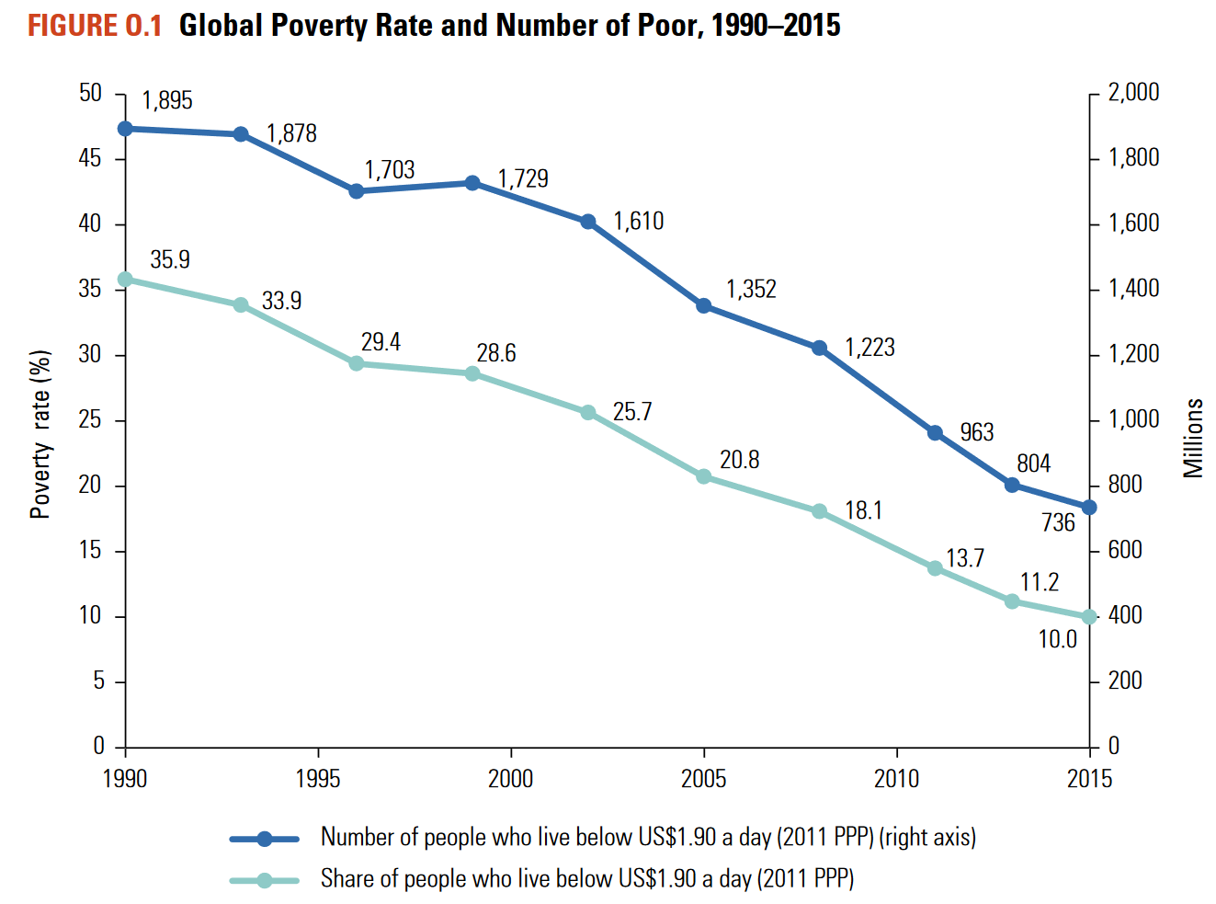
Global Poverty Trends

Slide 13
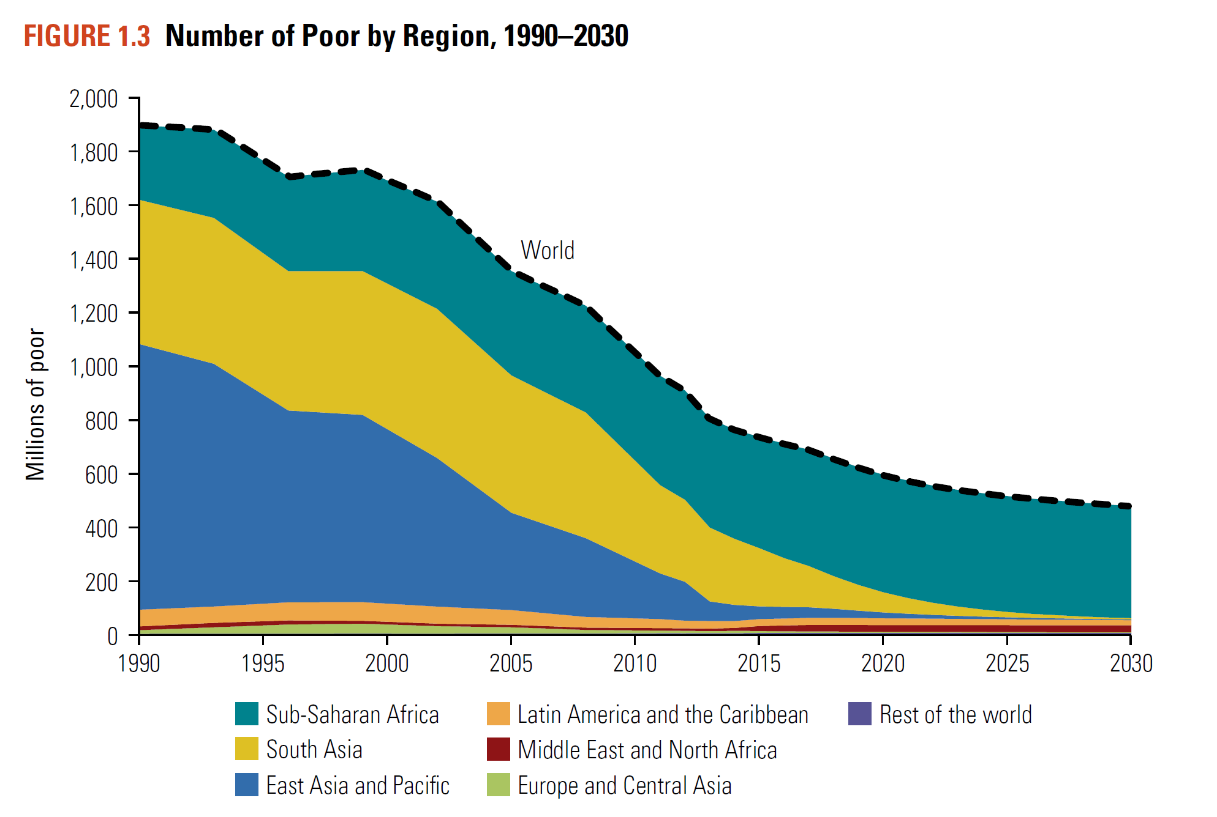
Global Poverty by Region
East Asia and Pacific – from 60% (1990) to less than 3% (2015)
“Extreme poverty is increasingly becoming a Sub-Saharan African problem” (World Bank, 2018)
Highest poverty (2015): India, Bangladesh, Congo, Nigeria, Ethiopia

Slide 14
Food Security and Undernourishment - Global
The worrisome trend in undernourishment continues
777 million in 2015 – 10.6%
815 million in 2016 – 10.8%
821 million in 2017 – 10.9%
Severe food insecurity affected 10.2% of global population (2017)
About 770 million people
8.9% in 2014
8.9% in 2016
Notes:
Prevalence in undernourishment is traditional measure – food supply, consumption, and energy needs by country; prevalence of severe food insecurity is based on interviews with adults

Slide 15
Growth in Climate Change Vulnerability
Risk of extreme weather events because of climate change is associate with an increase in undernourishment
For 36% of the countries that experienced a rise in undernourishment since 2005, this coincided with drought
51 low- or middle-income countries experienced early or delayed onsets of growing seasons, 29 experienced shorter seasons, and 28 experienced both in 2017

Slide 16
How does climate change affect hunger?
Food availability – floods, droughts, and storms destroy crops or threaten growing seasons; drought accounts for 80% of the global loss in agricultural production; increased imports
Food access – threats to livelihoods dependent on agriculture or climate; price spikes after climate-related crises (low supply)
Food utilization – reduced quality and diversity of foods because of high prices and low supplies; less safety in food – rainfall encourages mold growth; increased risk of salmonella in warmer conditions
Stability – increases in migration, severity of illnesses (e.g. kidney disease in arid regions and heatstroke), changes in livelihoods; scarce resources can trigger volatility and conflict

Slide 17
Nutritional Outcomes
Stunting
Defined as low height for age
Continues to decline, to 22% in 2017 (from 22.9% in 2016 and 29.5% in 2005)
151 million children under 5
Wasting
Defined as low weight for height
Usually result of low birth weight, inadequate diet, poor care practices, and infections
7.5% of children under five years of age (2017) – down from 7.7% in 2016
50 million children

