Slide 1
Facebook for your Ministry
Mary Frances
Congregational and Synodical mission
Divine Power Yoga

Slide 2
Tips from Facebook Fit for Small Biz
What to post
When to post
Reaching your target audience
Getting more LIKES
Facebook Advertising
Branding

Slide 3
What to Post
Your Facebook page is a reflection of your ministry
  Don’t use it as an electronic bulletin or newsletter
Post about PEOPLE not events
Keep it simple – 90 characters or less
Use good quality photos
Make sure ABOUT section is fully completed so people can find you
Be interactive but not pushy
Give people a reason to come back to your page

Slide 4
When to Post
Post 3-4x a week to increase audience engagement
  No more than ONCE a day
  Boosting posts can help but don’t do it all the time
You can schedule posts in advance to keep them regular when you aren’t available
Don’t ignore the seasons, holidays or current events

Slide 5
Reaching Your Target Audience/FB Ads
Inviting Page LIKES through Post LIKES
Keywords
  Expand Keywords to include broader topic
  Expand how you think about what people are looking for
  Newly moved
Demographic
Geographic
Interests
Behaviors

Slide 6
Audiences
Core audiences
  The people who already LIKE your page
Custom audiences
  Upload email list
  FB will find them and target them
Look Alike audiences
  FB will find people similar to your Custom Audience

Slide 7
Pages Manager/Ads Manager
It’s all mobile now
Trial and error
Be creative and nimble
Look at insights
  When are people online
  What are they doing
Have several ads
  Boost what is working, stop what is not
Try different pictures, same copy, etc.

Slide 8
Measurement
Impressions matter
  Click through does not
  Click through does not drive “sales”
Impressions convert
  99% of people purchased instore without clicking on an ad
Page insights/Ad insights to measure ad relevance

Slide 9
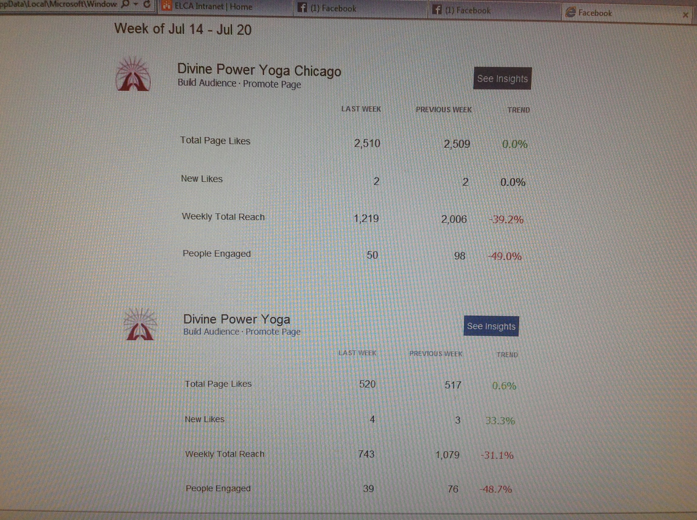

Slide 10
Branding
Everything connects, everything represents who you are
  FB Page
  Website
  Print Materials
  Logo
  Pictures

