Slide 1
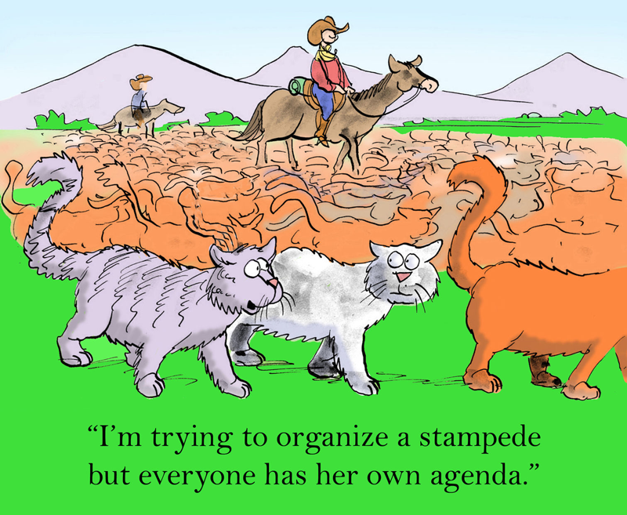
Leadership in the Church

Slide 2
Organizing for Mission
Session 1
Notes:
Discussion: Why does a church need to have an organization? What’s the point – the ultimate purpose?
What does the Bible have to say about it?
Prior to Acts 6, the organization seemed to rest in the hands of the twelve apostles
The first “organization” of the church came to support the ministry. Acts 6
Later Paul would identify five “offices” or “church leaders” in Eph 4:11–12
Also the mention of Elders by Paul to Timothy and Titus (1 Tim 5:17; Titus 1:50
But note: there’s no “prescribed” organizational principles, such as you find in the OT. The expectation seems to be organize as the church needs to.

Slide 3
Role of the Launch Team
Organizes and guides the ministry toward first public worship and related ministries
May oversee the work of several teams
Is temporary

Slide 4
Role of the Launch Team
Launch Team works on project such as
Where will we worship?
What do we need to make it happen?
How will we market this?
What about logistics?
Parking
Child Care
Food
Music
Chairs

Slide 5
Transitioning to Leadership Team
Can be known by many names
Vision Team, Steering Committee
Not a governance group
Does the work of guiding the overall vision of the ministry
Where are we going?
What is God calling us to do and be in this place?
How will we get there?

Slide 6
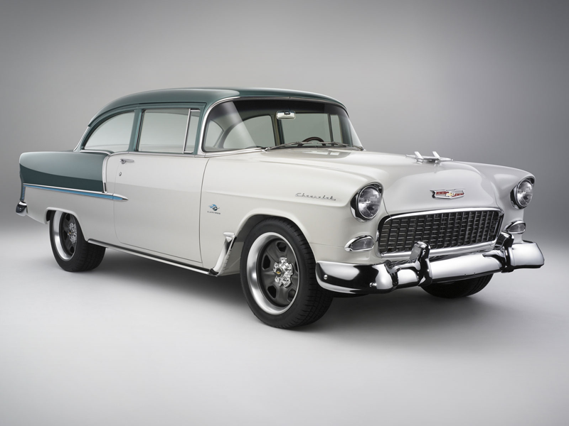
Back in the Day …
Notes:
Following the Big War, the church began taking its cue for organizational structures from big business – churches were suddenly filling up again and new systems were needed.
The days of centralized leadership and committees was born – and the Functional Committee system (among others) came to the fore.

Slide 7
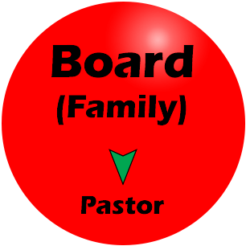
Churches Under 70
Notes:
No need for committees – the board pretty much runs everything. It both manages and implements
Church generally operates under a matriarch or patriarch.
The pastor is an employee hired to deal with church affairs.
What happens when the magic number of 70 is reached?
The board is unable to both manage and do the ministry
The matriarch/patriarch is unable to provide effective guidance and/or maintain control
The pastor is unable to meet all of the board’s expectations
Committees are born …

Slide 8
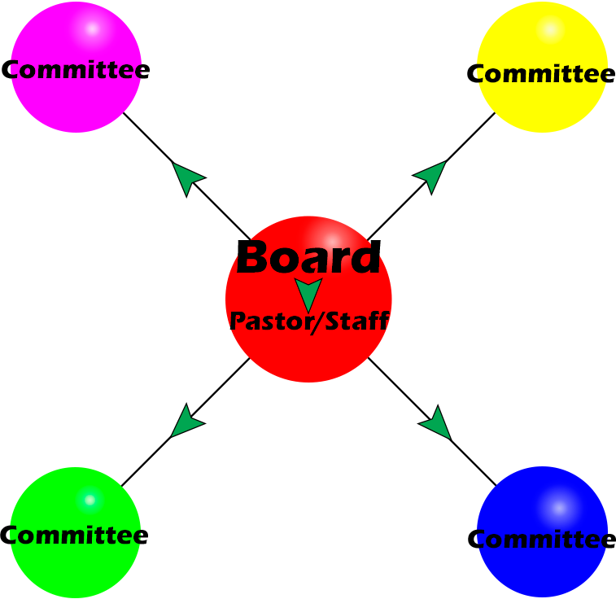
Churches to 150
Notes:
The board still maintains management oversight/control
Virtually all decisions are made by the board
Committees exist to make recommendations and to implement the board’s agenda
Pastor/staff is supervised by the board and are expected to be onsite participants/delegates on behalf of the board
This works to 150
As a church continues to grow:
The number of needed committees begins to grow.
The number of decisions necessary begins to overwhelm the board
The decision making process creates a bottleneck and effective ministry opportunities are lost
A new structure is needed to go to the next level … but if you think the first transition created conflict, watch out!
The next level of organization is called the Brick Ceiling – very few churches break through it

Slide 9
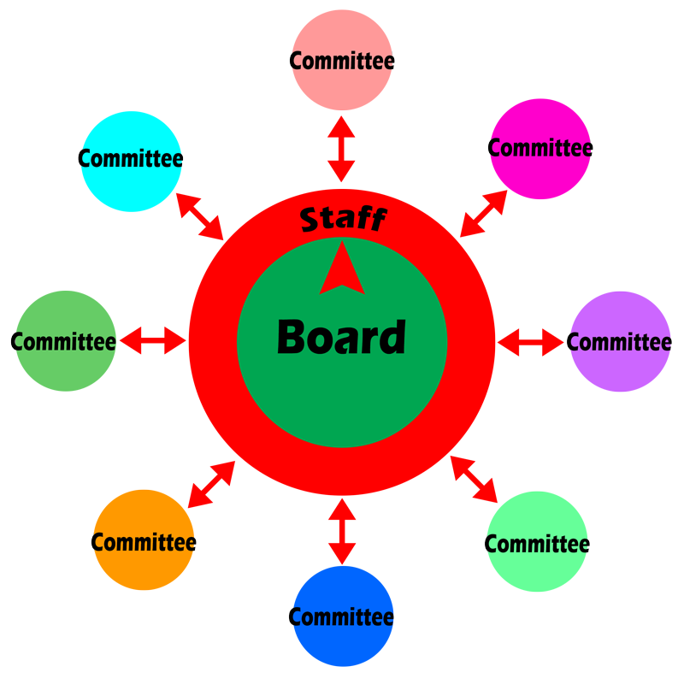
Churches to 300
Notes:
At this level, the board is still firmly in control … of staff, but the lead pastor is the primary supervisor of staff
Each committee has a staff liaison – typically, a staff member of each committee
Committees have specific mandates and rubrics – stay within budget, limited tenure for leaders
Significant decision making is given to the committees who coordinate with staff
Board agendas are information sharing meetings with limited (but significant) decision making responsibilities
The conflict arises because the staff now has significant “power” and decision making responsibilities. The board (and the congregation at large) are left out of the decision making loop. Leaders and members have to give up most of their control as staff and committee leaders make decisions “without asking me!” or getting board permission.
IF – and that’s a BIG IF – the church successfully navigates this hurdle, and
IF the church continues to grow:
Committees multiply exponentially
More committees means more reports and details that need to be dealt with – the board gets increasingly bogged down in minutiae
More committees means more staff
But the church can only afford a limited number of staff members
Staff begins to burn out and ministries become less than excellent
Staff turnouver becomes a serious problem

Slide 10
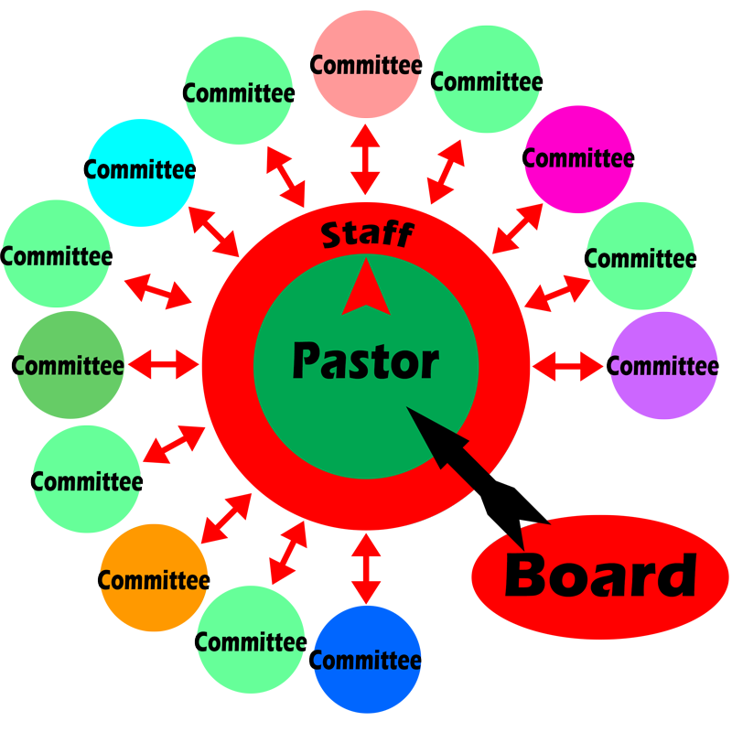
Churches to 500
Notes:
At 500 there’s yet another organizational reorganization
At this level:
The pastor becomes the core decision maker
Staff is organized and supervised directly by the pastor
Committees function nearly autonomously
The pastor spends the majority of his/her time in meetings
The staff’s spends the majority of their time coordinating ministry in their particular area – meaning they spend much of their time in meetings
The larger the church, the more events/programs/ministries the staff members have to oversee and be involved in
The board’s primary task is overseeing the pastor, but often inserts itself in decision making
At this size and above, the congregation as a whole is relatively unaware of the organizational changes
The changes, however, create significant staff issues – and board issues. Typically staff find themselves serving multiple “bosses” – HR, the board, the pastor
The changes always bring serious staff stress
These reorganizations must take place at 800, 1000, 1500, 2000 etc.

Slide 11
Repeated Re-Organization is Not the Answer
500
300
150
70
Notes:
There’s a better way to organize – a scalable model

Slide 12
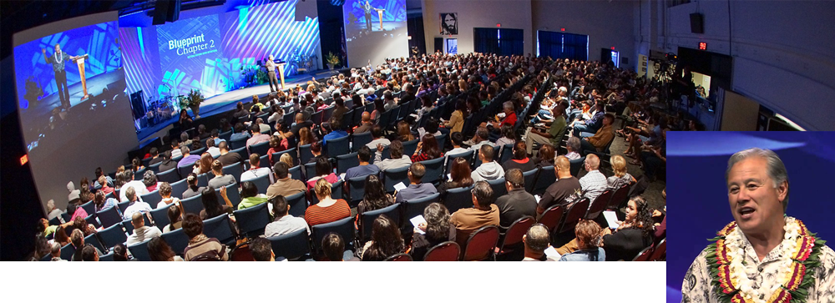
We Need a Scalable Organizational Model
Notes:
Wayne Cordeiro, New Hope Church, Ouahu, Hawaii

Slide 13
Fractals
Notes:
Wayne Cordeiro noted the repeating pattern in leaves … actually, for him it was palm fronds
Fractals are a repeating pattern

Slide 14
Fractals
Notes:
Note the veins repeat

Slide 15
Fractals
Notes:
And they keep repeating nearly to the molecular level

Slide 16
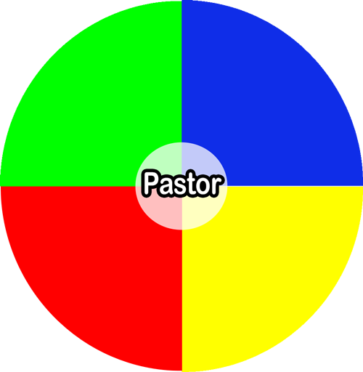
Fractals as an Organizational Principle
Notes:
Wayne divided his job into four key parts based on the church’s mission.
Over the years, we’ve adapted the fractal model to reflect what we call the Four Core Processes – these are the four processes that every effective, faithful, and sustainable church must have in place.

Slide 17
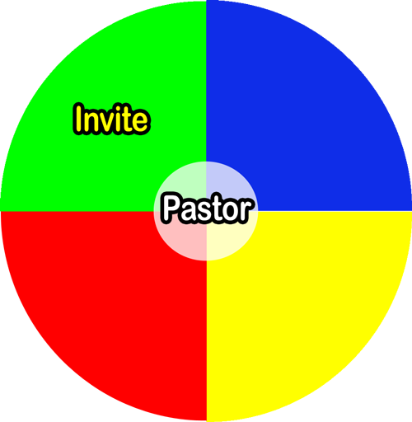
Fractals as an Organizational Principle
Notes:
Invite – Bring people into the church

Slide 18
Fractals as an Organizational Principle
Notes:
Connect – Retain them long enough to disciple them

Slide 19
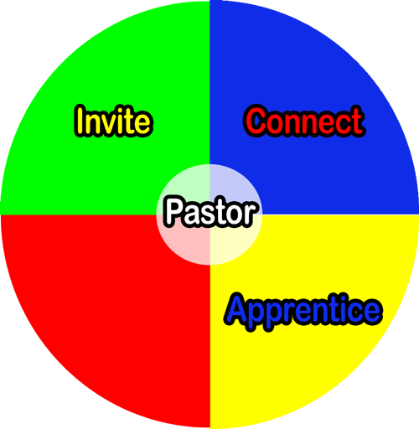
Fractals as an Organizational Principle
Notes:
Apprentice – make them faithful disciples – followers in thought, word, and deed – of Jesus Christ

Slide 20
Fractals as an Organizational Principle
Notes:
Send – Send them back into their neighborhood and workplace as missionaries
Note that the buck stops with the pastor who is ultimately responsible for every ministry, program, event, mission project … in other words, everything the church does.
BUT … responsible doesn’t mean “do”
Leaders lead … they don’t “do” …

Slide 21
Fractals as an Organizational Principle
Notes:
Fractal as scalable organization …
Pastor responsible for everything: raises up four Key Leaders who are responsible for the attainment of their core processes
One key advantage to this system … the pastor only has to directly supervise four people and he holds each one accountable for results … just like the council holds the pastor accountable
(Note: if the pastor doesn’t have the authority to hire and fire, then he cannot be held responsible for vision attainment)

Slide 22
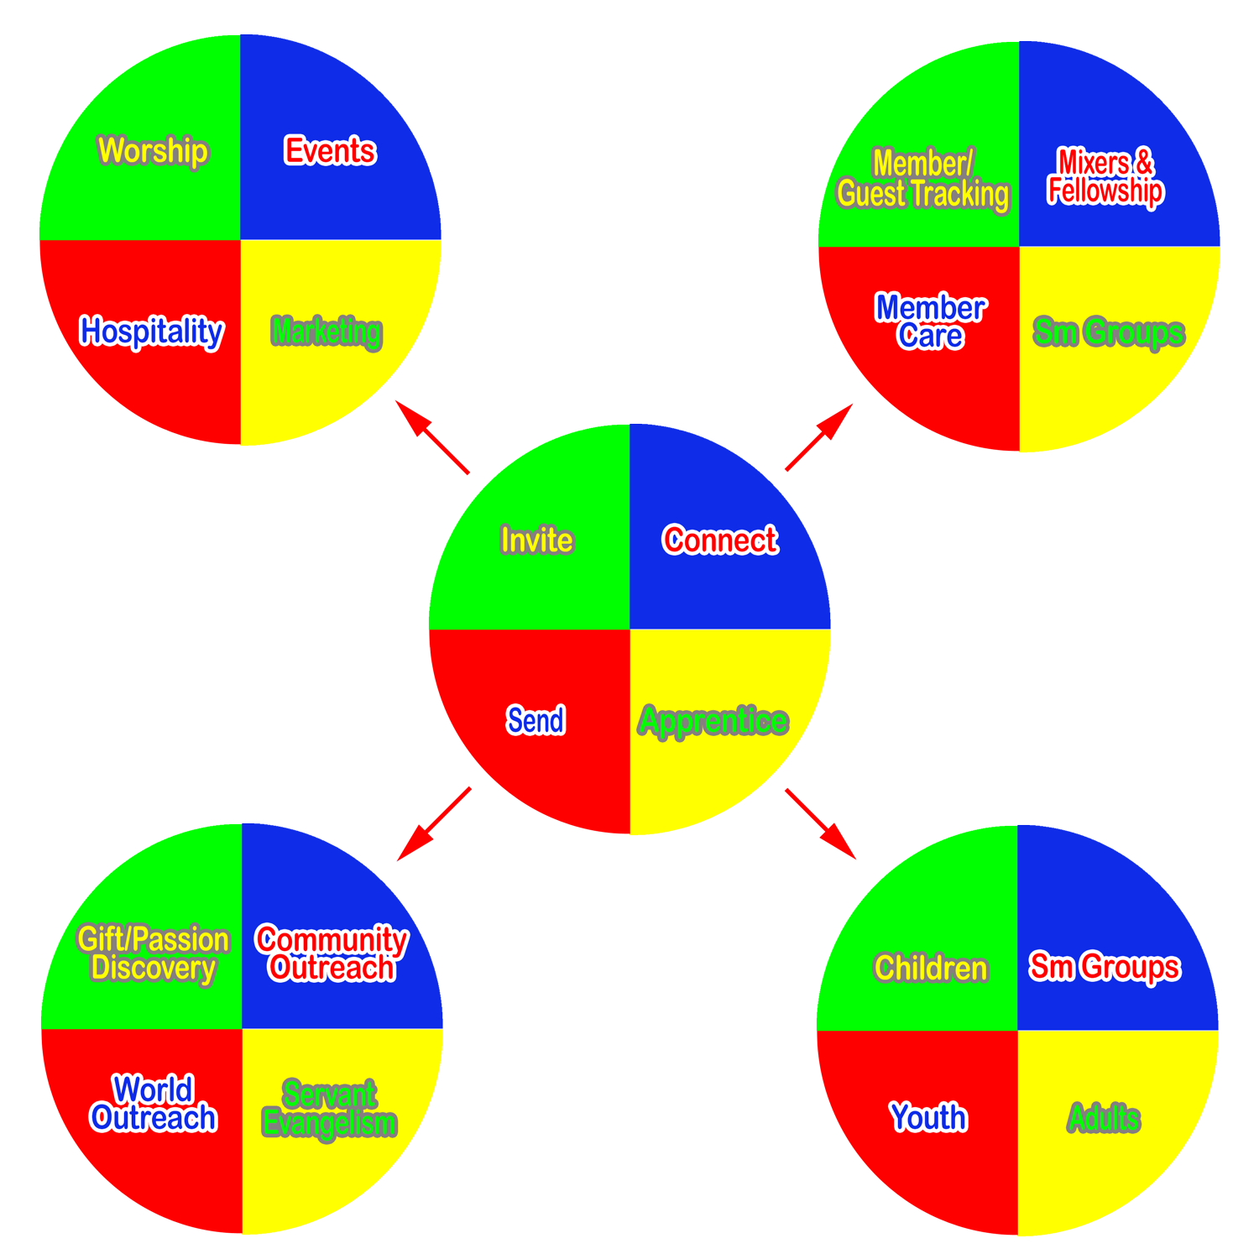
Fractals as Scalable Organization
Notes:
Each Key leader raises up for leaders to accomplish their core process
For instance …

Slide 23
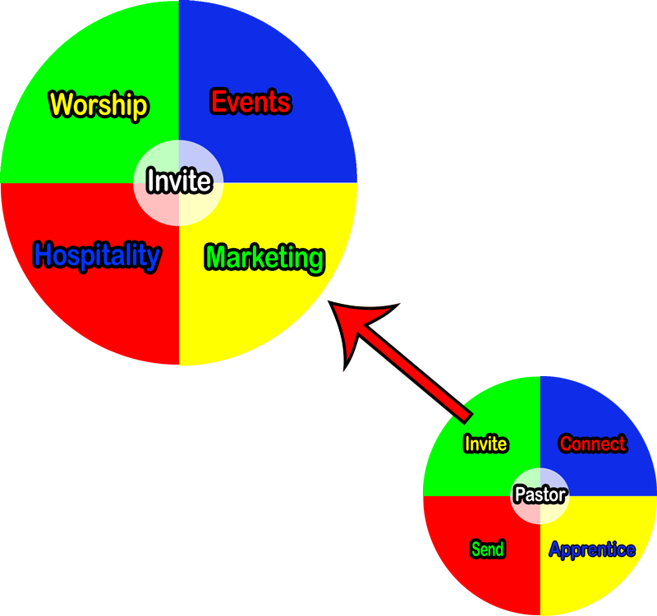
Fractals as Scalable Organization
Notes:
The invite pastor’s fractal – The Invite Key Leader only has to supervise four people …

Slide 24
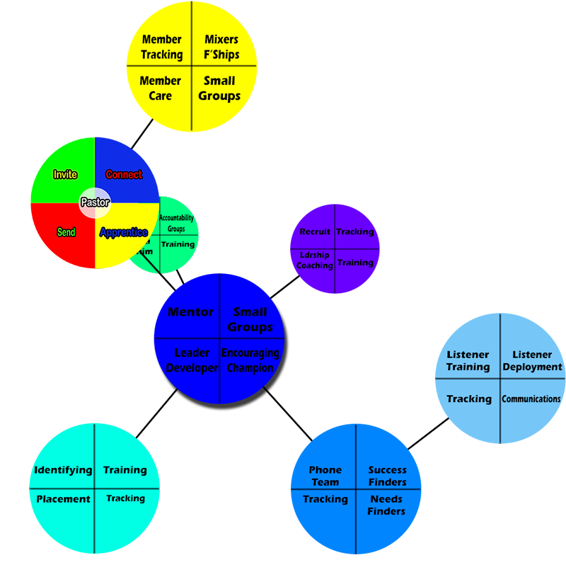
Fractals as Scalable Organization
Notes:
Here’s what two leaders did with their fractal organizations …
Next slide for blowup

Slide 26
Assignment
Draw your main fractal and your four key processes.
Write the jobs you need to give away on post-it notes and put on the other fractals

Slide 27
Questions?

Slide 28
Build Your Core Leaders
Get the right people on the bus

Slide 29
1. Select Leaders Carefully
Choose spiritually grounded leaders
Choose trustworthy leaders
Implement the One Person, One Passion, One Position policy
Leaders must lead from their passion
Leaders must lead …
Develop a leadership covenant
Notes:
It’s okay if not everything gets done.

Slide 30
2. Lead Effectively
Keep the leadership team small
Eliminate as many meetings as possible
Empower your leaders to make decisions

