Slide 1
Another way to observe & renew the Reformation

Slide 2
How can churches include ALL of God’s Creation in our Ministries?

Slide 3
Love for Neighbor… who is that?
Personal
Local
Global
The voiceless:
The Poor
The Future Generations
The Natural World

Slide 4
Personally: Who are the neighbors we don’t see or think of?
Microbial life in the soil, water, air and ALL OVER OUR BODIES!

Slide 5
Locally: How does your lifestyle impact the people you share an ecosystem with?
Watersheds: everything you put down the drain, on the lawn and in your body ends up somewhere else.
Everything “breathes”: smell something? taste fake?
Use ALL the senses God gave us to explore, appreciate and care for our common home.

Slide 6
Globally What is the true cost of our choices?
Transportation costs
Treatment of workers
Public health conditions in communities where items are produced & disposed
Effects on all life of insecticides and herbicides
Waste that never goes “away”

Slide 7
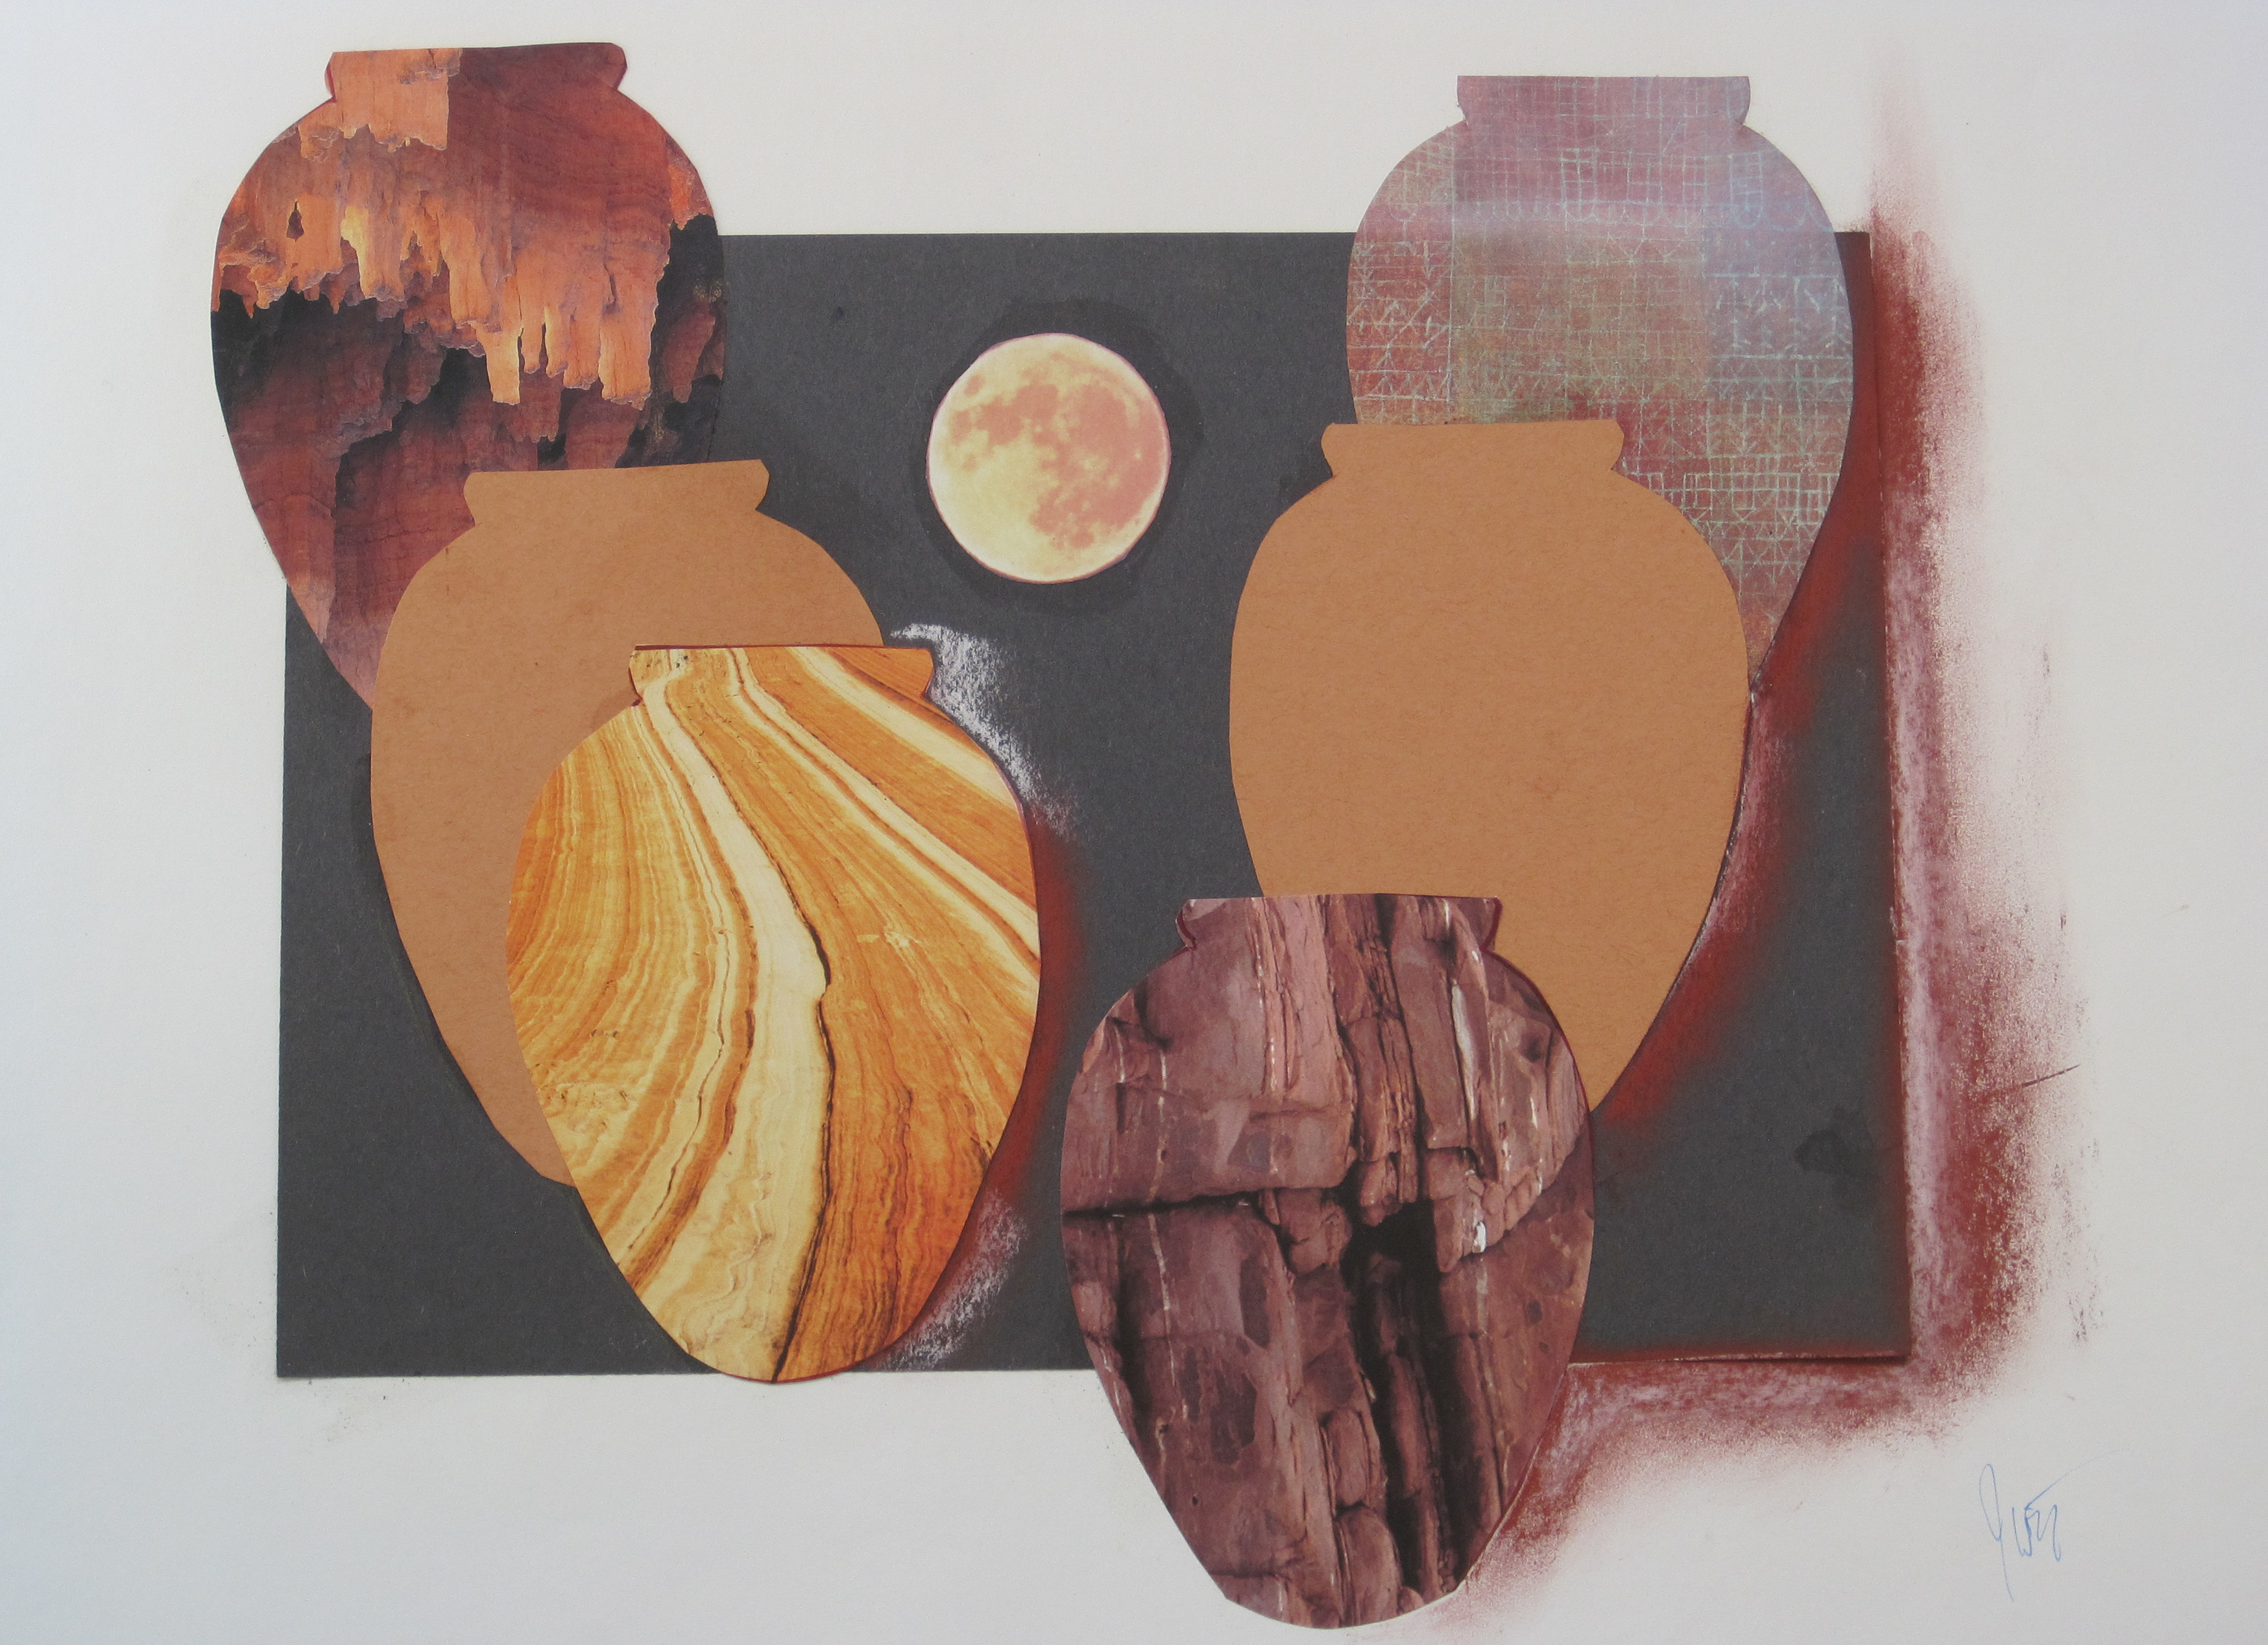
INSIDE CHURCH
Increase Awareness & Appreciation:
Practice using ALL the senses for Bible Study (Art & Sacred Story – Nature Journaling)
Seek integrative tools:
EarthBound DVD series
God’s Call to Earthkeeping Devotions

Slide 8
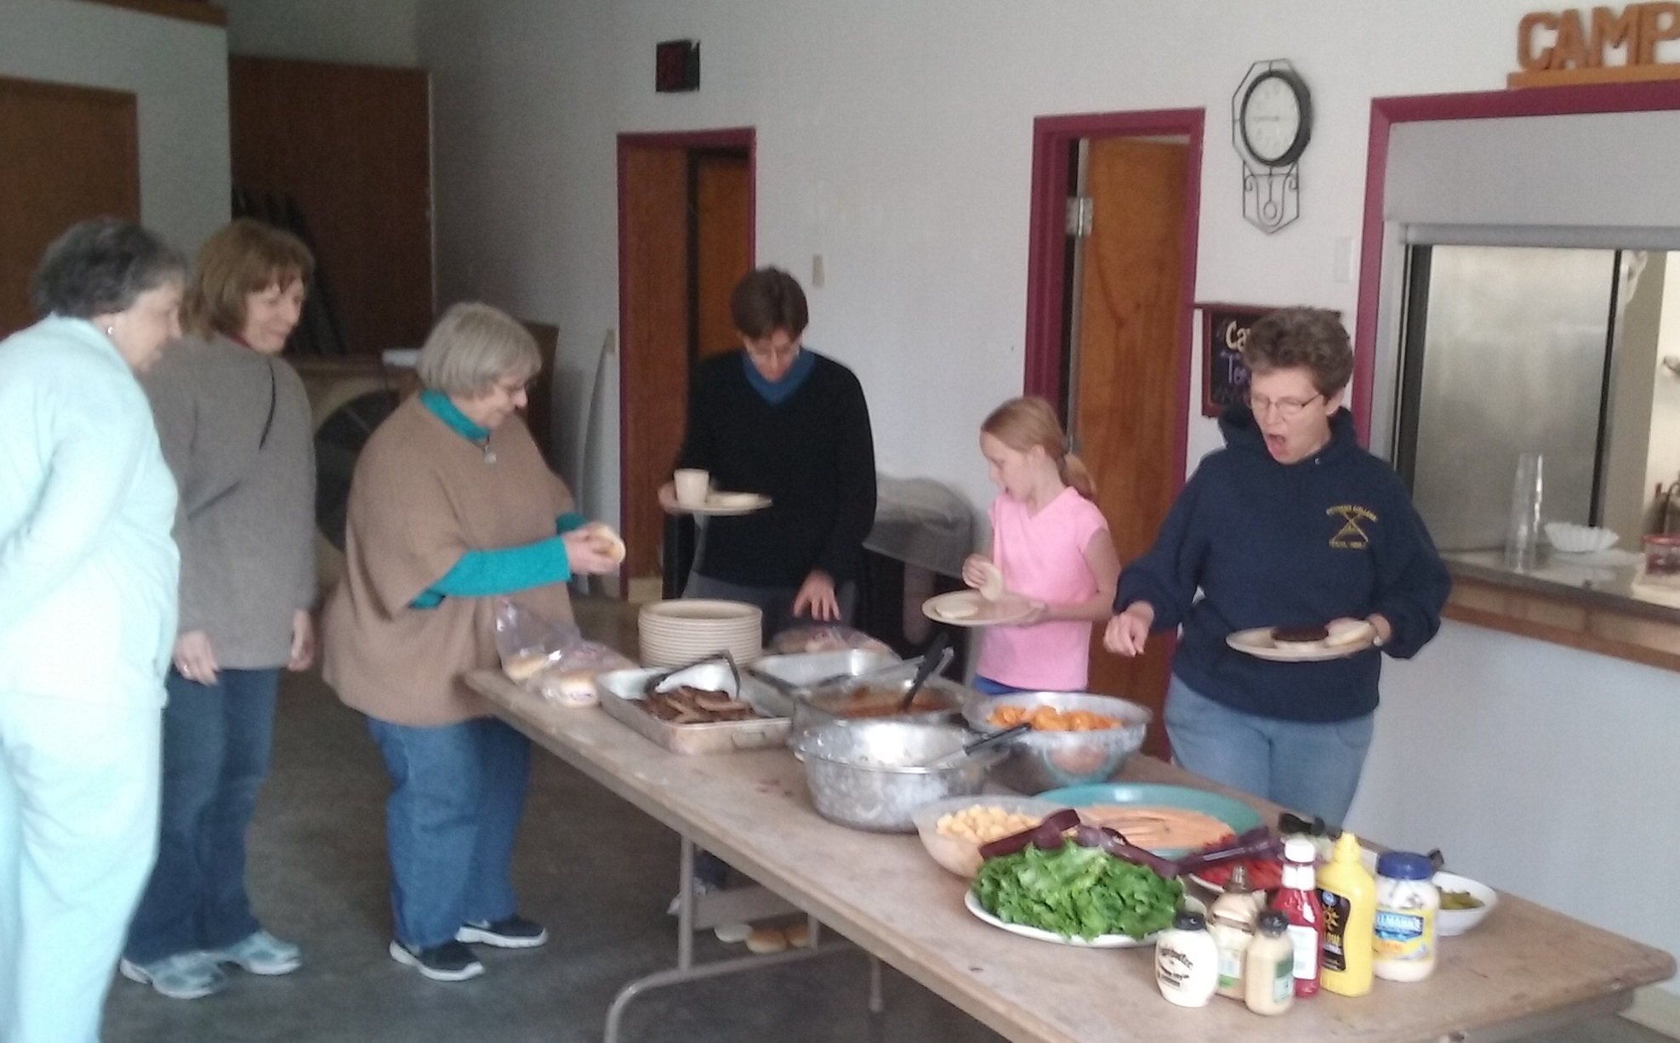
INSIDE CHURCH
Sustainable habits:
POT-LUCKS CONSIDERING FOOD SOURCES
REDUCE DISPOSABLES
ECO-FRIENDLY CLEANERS
CARE FOR THE WHOLE FACILITY
AS IF YOU WOULD EAT THERE

Slide 9
OUTSIDE the CHURCH
Think – Share – Act:
Tools from ELCA Advocacy –
speak into the microphone with resources like Ruth Ivory-Moore!
Experiences, connections and resources from other churches…

Slide 10
Stories from the Field

Slide 11
What does a Watershed Moment look like?

Slide 12
Experiment – Play - Pray
Take out a map and see what watersheds your congregation is a part of
Plan ahead and make a water month
Gather a team (worship, music, education, outreach, etc.) in advance
Explore then embed resources into worship, committees, and the life of the church for a month or more including but not limited to:
■ Invite watershed experts
■ Offer service opportunities
■ Political advocacy

Slide 13
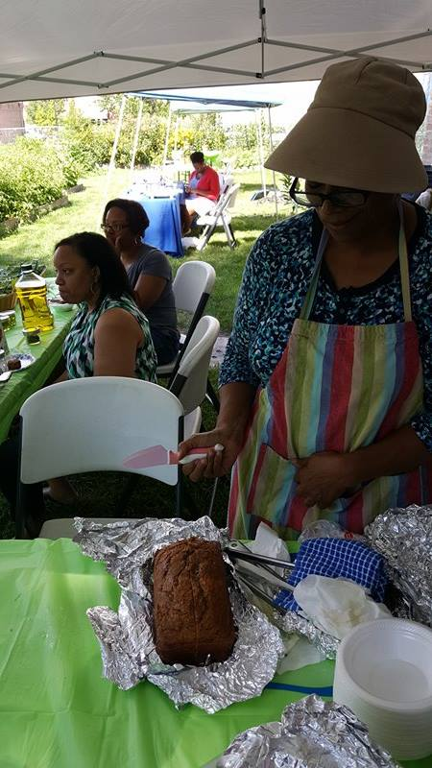
GROW & SERVE

Slide 14
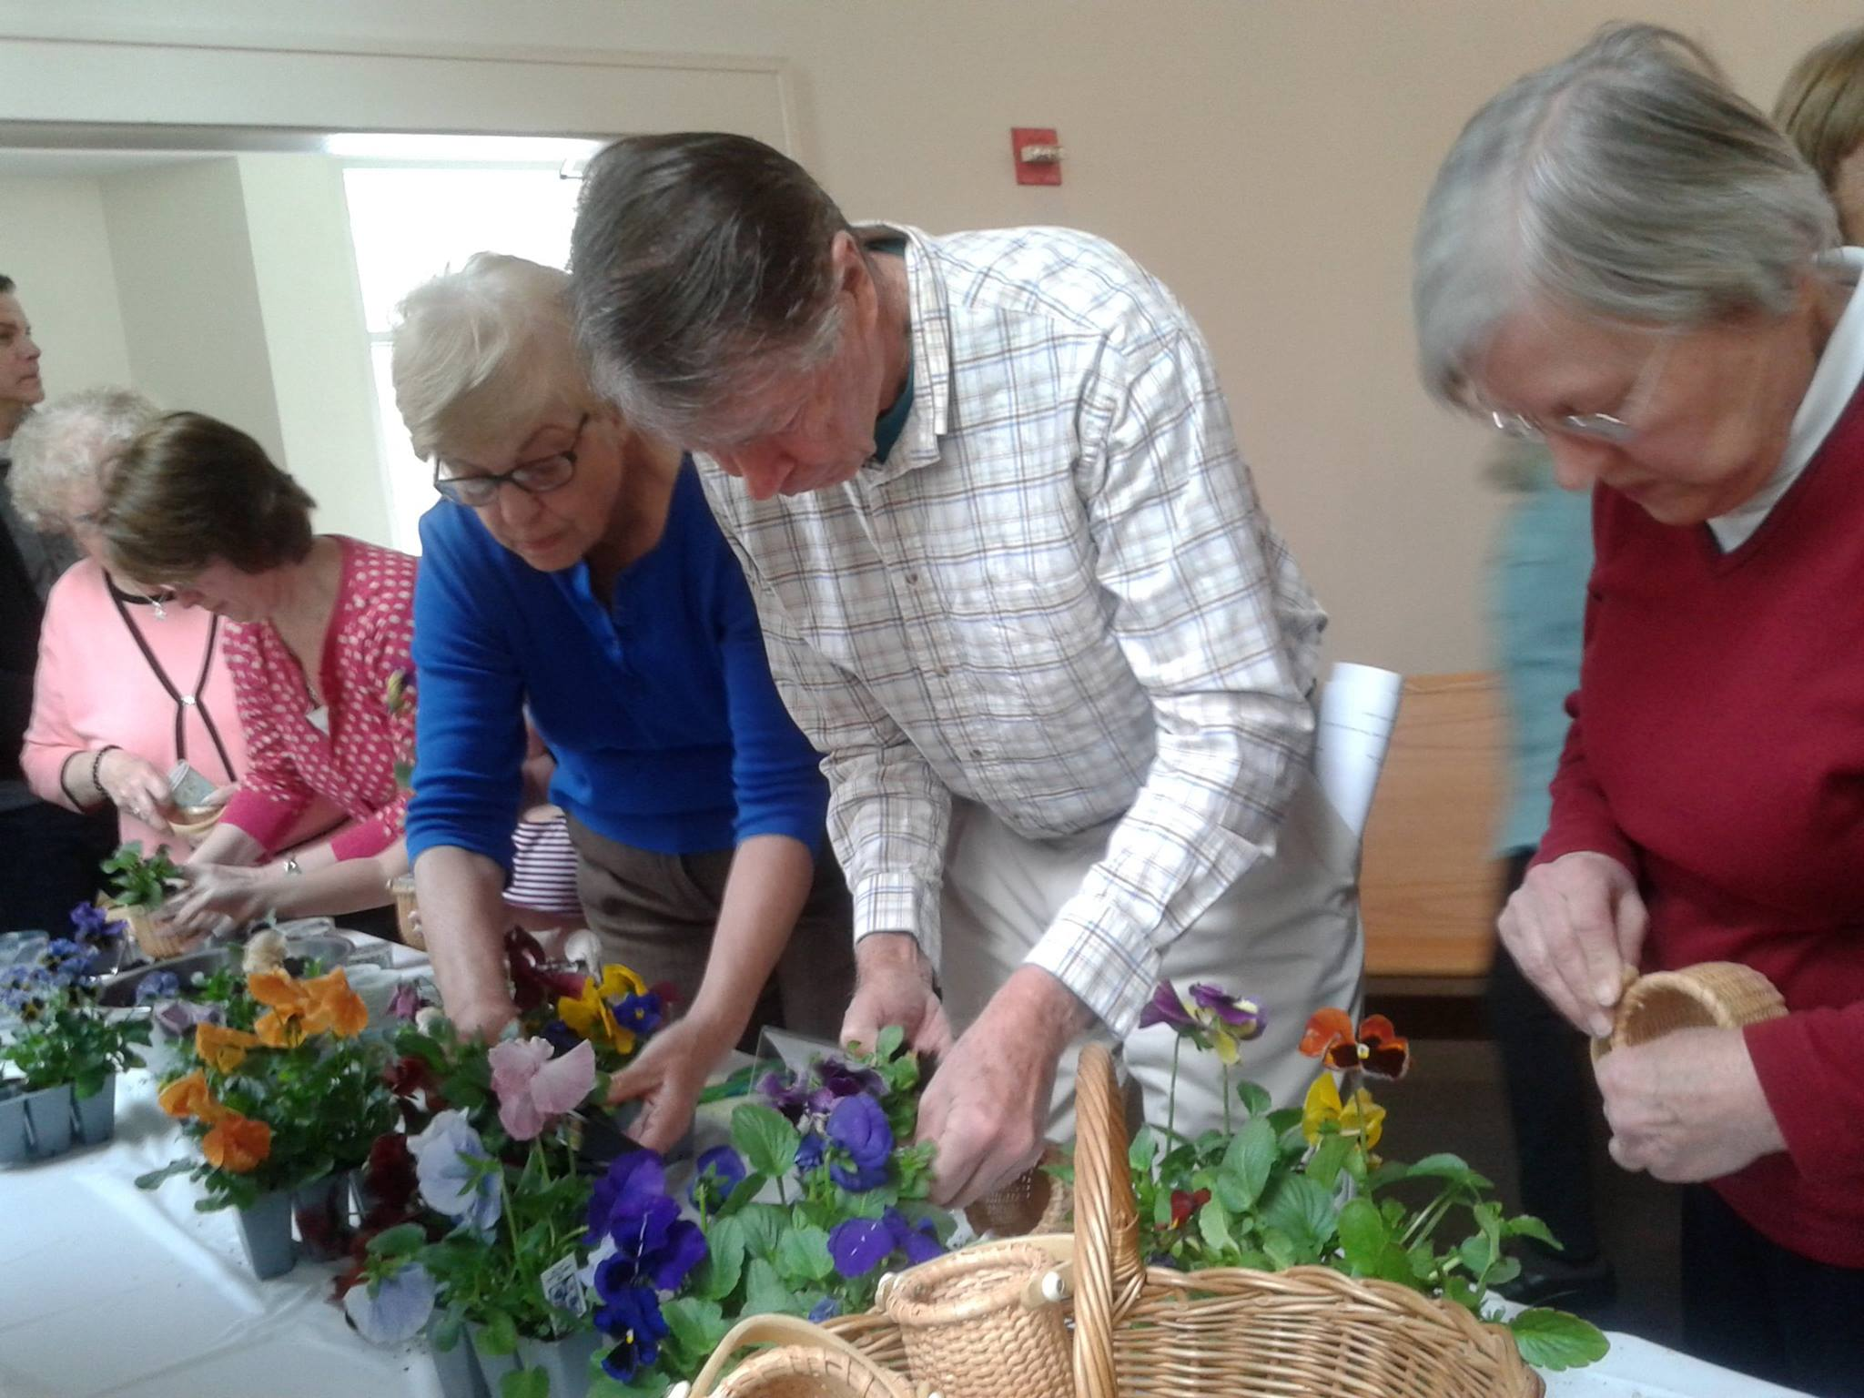
New Images of Worship:

Slide 15
What happens in YOUR CHURCH?
Energy Stewards Initiative or Energy Star
Blessing of the Animals
Farmer’s Market or ELCA World Hunger Garden
Documentary movie nights – open to the community
Tree Plantings
Outdoor Ministry Camp trips - with confirmation kids, intergenerational
Vacation Bible School theme

Slide 16
Set a goal & don’t do it alone
Leave us your name, Synod, email and ideas for next steps in your church & we’ll follow up with you before summer’s end!
Visit www.LutheransRestoringCreation.org for a copy of this presentation and all Care for Creation information shared at Churchwide Assembly.

